Slide 1

BB84 Quantum Key Distribution Demonstrator for Secure
Communication
BY
2511CS040019 N.Spoorthi
2511CS040015 A.Akshitha
2511CS040006 M.Sai Nikhitha
2511CS040046 Saniya
Under the Guidance of
Mr.P.Ramesh
Assistant professor
Department of Cyber Security
School of Engineering
Malla Reddy University
Hyderabad, Telangana, INDIA

Slide 2
1. Introduction
1.1 Problem Definition & Description
In conventional communication systems, sensitive information is protected using mathematical encryption techniques. However, the security of these methods can be threatened by powerful computing systems and future quantum computers.
A secure communication system is needed that can detect the presence of an eavesdropper during key exchange. Quantum Key Distribution (QKD) provides a solution by using the principles of quantum mechanics to securely generate and distribute encryption keys.
The BB84 protocol is one of the earliest and most widely studied QKD protocols. This project demonstrates the working of BB84 using a hardware-based setup, allowing users to understand secure key generation, measurement, eavesdropping detection, and communication.

Slide 3
ABSTRACT
The BB84 Quantum Key Distribution Demonstrator is designed to demonstrate secure communication using the principles of quantum key distribution. The system consists of a sender, receiver, and communication channel that work together to generate a shared secret key. Different quantum states and measurement bases are represented using hardware components to demonstrate the BB84 protocol. The receiver randomly selects measurement bases, and matching bases are used to generate the final key. The system can also simulate an eavesdropper and detect unauthorized interception through the errors introduced during transmission. This project provides a simple, interactive, and practical understanding of quantum-based secure communication and demonstrates how the BB84 protocol can improve the security of key exchange.

Slide 4
1. Introduction
1.2 Objectives of the Project
Demonstrate BB84 Protocol: Implement the basic working principles of the BB84 Quantum Key Distribution protocol using hardware.
Generate Secure Keys: Generate a shared secret key between the sender and receiver using quantum-inspired polarization states.
Detect Eavesdropping: Demonstrate how an eavesdropper can introduce errors during the key exchange process.
Understand Quantum Security: Provide a practical demonstration of how quantum principles can improve communication security.
Provide Real-Time Demonstration: Display the generated bits, measurement results, errors, and final key using hardware components.

Slide 5
1. Introduction
1.3 Aim of the Project
The aim of the BB84 Quantum Key Distribution Demonstrator is to develop a hardware-based system that demonstrates secure key exchange using the BB84 protocol.
The system allows a sender and receiver to generate a shared secret key while identifying possible eavesdropping attempts. By using optical/LED-based communication and electronic components, the project provides a practical demonstration of quantum key distribution concepts and secure communication.

Slide 6
2. Methodology
1. Bit Generation:
The sender generates a random sequence of binary bits.
2. Basis Selection:
The sender randomly selects a basis for each bit.
3. Quantum State Transmission:
The selected bit and basis are represented using different optical/LED states and transmitted to the receiver.
4. Random Measurement:
The receiver independently chooses random measurement bases to measure the received states.
5. Basis Comparison:
The sender and receiver publicly compare their selected bases without revealing the actual bit values.
6. Key Sifting:
Only the bits measured using matching bases are retained to form the sifted key.
7. Eavesdropper Detection:
A sample of the sifted key is compared. Unexpected errors indicate possible eavesdropping.
8. Final Key Generation:
If the error rate is within the acceptable range, the remaining matching bits are used as the shared secret key.

Slide 7
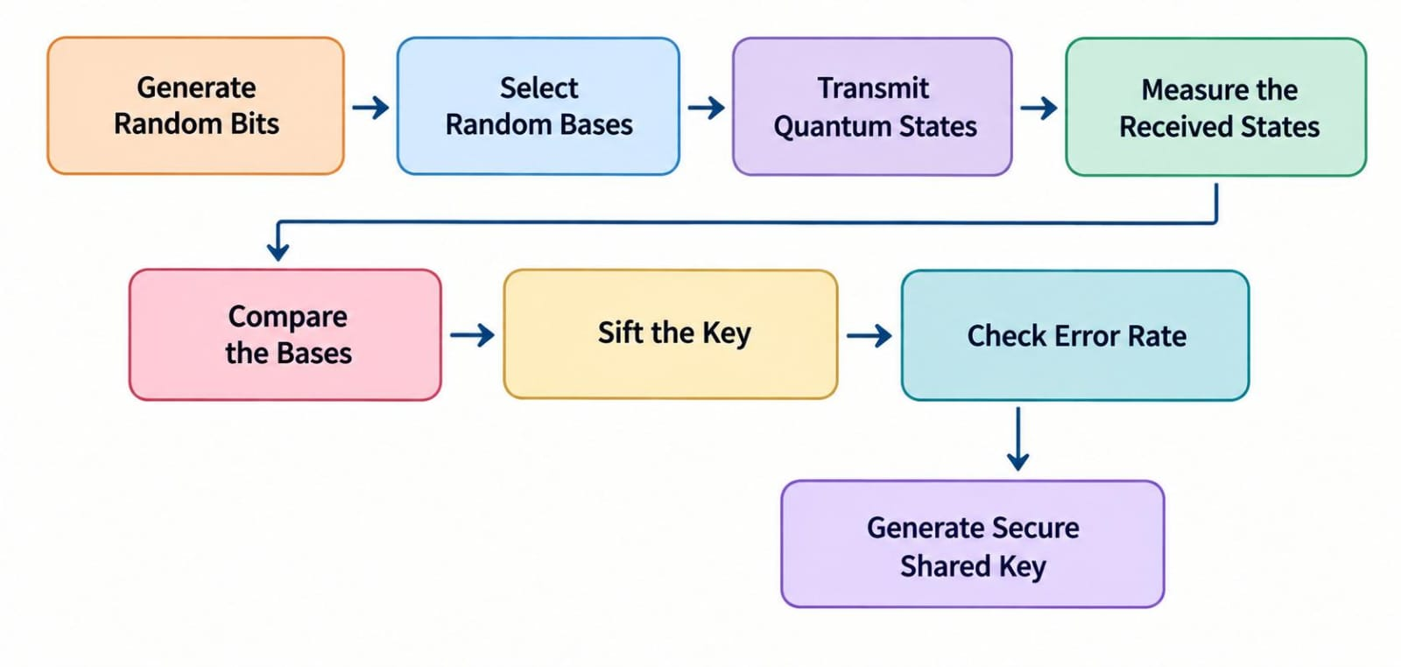
2.1 Methodology

Slide 8
3. Requirements
3.1 Hardware Requirements
Microcontroller: Arduino Uno / compatible microcontroller
LEDs: LEDs for representing different quantum states/bases
Photodiodes / Light Sensors: Used to detect transmitted optical signals
Resistors: For LED and sensor circuit protection
Breadboard: For circuit assembly and testing
Jumper Wires: For component connections
Push Buttons: For basis selection and user interaction
LCD/OLED Display: To display bits, bases, errors, and generated key
Power Supply: USB / battery-based power source
Optional Components: Laser/LED module and optical filters for advanced demonstration

Slide 9
3. Requirements
3.2 Software Requirements
Programming Language: C / C++ for Arduino
Development Environment: Arduino IDE
Communication: Serial Monitor / USB Communication
Operating System: Windows 10 / Windows 11
Optional Simulation: Python for testing and visualizing the BB84 proto

Slide 10
4. System Analysis
4.1 Literature Survey
Quantum Key Distribution: Quantum Key Distribution is a secure key exchange technique based on the principles of quantum mechanics. It enables two parties to establish a shared secret key while providing the ability to detect eavesdropping.
BB84 Protocol: The BB84 protocol was introduced by Charles Bennett and Gilles Brassard in 1984. It uses different quantum bases to encode and measure information. Incorrect measurement by an eavesdropper can introduce detectable errors.
Quantum Communication: Quantum communication uses quantum states to transmit information. The fundamental properties of quantum systems make unauthorized measurement detectable.
Hardware-Based Demonstration: Hardware demonstrators can help students understand the practical operation of QKD by representing quantum states using optical and electronic components.

Slide 11
5. System Analysis
5.1 Existing System
Traditional secure communication systems mainly use mathematical cryptographic algorithms for encryption and key exchange.
Although these methods provide strong security, they generally cannot directly detect whether an attacker has intercepted the key during transmission.
Conventional demonstrations of quantum communication are also often simulation-based, making it difficult for beginners to visualize the actual communication process.
These limitations create a need for a simple and interactive hardware-based demonstrator for understanding Quantum Key Distribution.

Slide 12
5. System Analysis
5.2 Existing System
Limitations of Existing System
Traditional key exchange depends mainly on mathematical security.
Eavesdropping during key exchange may not be directly detectable.
Quantum communication concepts are difficult to understand theoretically.
Many learning demonstrations are completely software/simulation based.
Physical implementation of QKD concepts is not easily accessible for students.
Lack of an interactive hardware model for demonstrating BB84.

Slide 13
5. System Analysis
5.3 Proposed System
Hardware-Based BB84 Demonstrator:
Develop a physical system to demonstrate the BB84 Quantum Key Distribution protocol.
Random Bit Generation:
Generate random binary bits and randomly select communication bases.
Quantum State Representation:
Represent different BB84 states using LEDs/optical signals and sensors.
Secure Key Generation:
Generate a shared key after comparing the sender's and receiver's bases.
Eavesdropping Detection:
Introduce an optional eavesdropper and demonstrate the increase in error rate.
Real-Time Display:
Display communication states, matching bases, errors, and final key on an LCD/OLED or serial monitor.

Slide 14
5. System Analysis
5.3 Proposed System
Advantages of Proposed System
Practical Learning: Provides a physical demonstration of Quantum Key Distribution.
Eavesdropping Detection: Demonstrates how interception can introduce detectable errors.
Interactive System: Users can observe the complete key-generation process.
Educational: Helps students understand BB84 concepts more easily.
Low-Cost Prototype: Uses commonly available electronic and optical components.
Real-Time Demonstration: Shows the communication process and generated key instantly.
Scalable: The prototype can be enhanced with better optical components and advanced quantum communication techniques.

Slide 15
5. System Analysis
5.3 Proposed System
Key Features of proposed system
BB84 Quantum Key Distribution demonstration
Random bit and basis generation
Quantum state representation using optical/LED signals
Sender and receiver communication
Random measurement basis selection
Key sifting
Eavesdropper simulation
Error-rate calculation
Eavesdropping detection
Shared secret key generation
LCD/OLED/Serial Monitor output
Interactive hardware-based demonstration

Slide 16
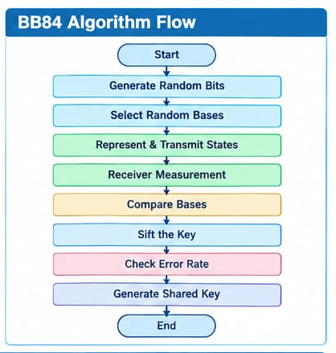
Modules & Algorithm Design

Slide 17
Backend Integration & Testing
Planned Software Setup
Microcontroller: ESP32
Programming Language: C/C++
Development Environment: Arduino IDE
Communication: Serial Monitor / USB
ESP32 will control the LEDs and read sensor inputs
BB84 processing will be implemented in the ESP32
Current Status
Software implementation — Completed
Backend integration — Completed
Complete testing — Completed

Slide 18
Prototype / Working Model Status
Hardware Progress
ESP32 available
Required LEDs/components available
Sensors available
Breadboard and jumper wires available
Hardware connection/setup in progress
Software Progress
BB84 algorithm flow Designed and Completed
ESP32 programming Completed
Hardware-software integration Complete
Complete working demonstration Successfully achieved

Slide 19
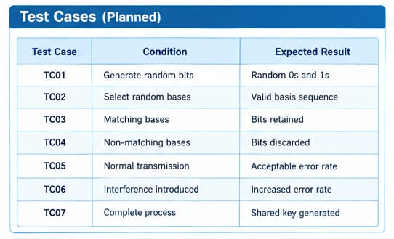
Results & Test Case Analysis

Slide 20
Thank you

